Slide 1
“Who knows English best”

Slide 2
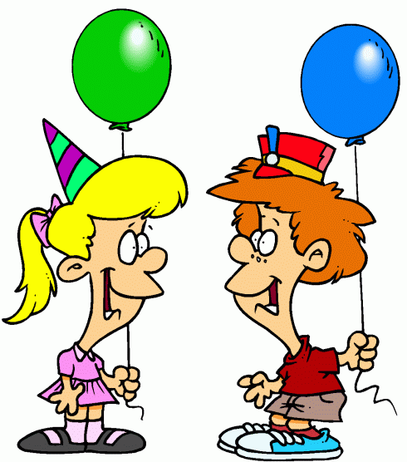
Speak About
Yourself

Slide 3
1. What is your surname?
2. Where are you from?
3. What form are you in?
4. Who is your best friend?
5. What time do you usually go to school?
6. What is your favourite subjеct?
7. Is sport important for you?
8. What kinds of sport do you know? ?
9. When is your birthday?
10. What is your favourite sport??
11. Are you good at English?
12. What is your favorite food?

Slide 4
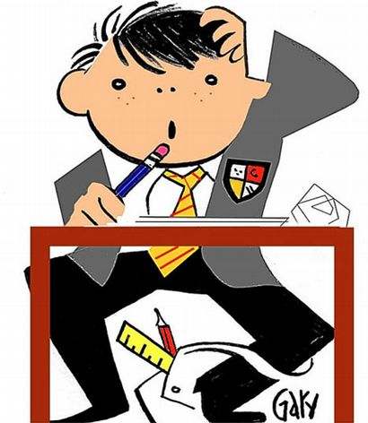
The Quickest

Slide 5
1. Where do kangaroos live? 2. Where is Ukraine situated? 3.What is the national dish of the Ukrainians? 4. What is the official language of Great Britain? 5. What is the fastest way of travelling? 6. What season comes after winter?

Slide 6
7. When do people usually have breakfast? 8. How many eyes has a man? 9. What sport is the most popular in Ukraine? 10. I cleaned my room yesterday. What’s the tense? 11. Name the odd word: tree, flower, sun, grass 12. What is the weather like usually in summer?

Slide 7
13. What’s the British national drink? 14. Why do people go to bed? 15. What river does Kyiv stand on? 16. You’ve got a litre of milk. How many 200 ml glasses can you fill? 17. How many oceans are there in the world? 18. A place where you can learn to swim?

Slide 8
19. What colour is snow? 20. How many players are there in a basketball team? 21.When do we use our muscles? 22.Sam is sleeping now. Name the tense 23. What days of the week children don’t go to school?

Slide 9
Draw the Story

Slide 10
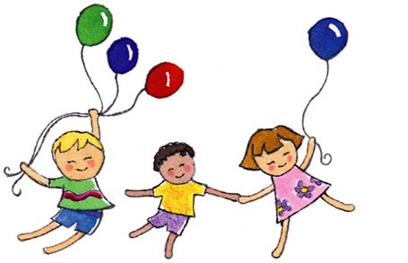
Relax
Sing a Song

Slide 11
Pantomime

Slide 12
Matching Words

Slide 13
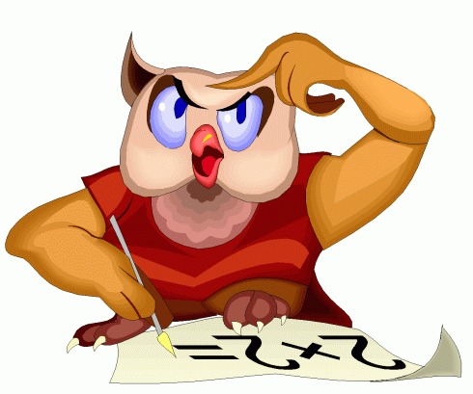
Guess Riddles

Slide 14
1. It can not talk but it can bark
2. It can live without water for a long time
3. I’m coloured, I’m bright I can walk run and
fly. I cannot swim but I can sing usually in
the morning
4. What animals has long hair round it’s neck
5. It is a domestic animals and it likes fish
6. When I eat I live. But when I drink, I die.
What am I?
7.This animal likes grass. It is a domestic
animals, it gives milk
8. What star is not seen in the sky?

Slide 15
Good Bye!

