Slide 1
Words of over the world!

Slide 2
We tried to know HOW PEOPLE CAN UNDERSTAND EACH OTHER ☺
1. We are different.
2. We live in different countries far from each other.
3. We have different traditions, religions, hobbies.
4. We have got even different appearance.

Slide 3
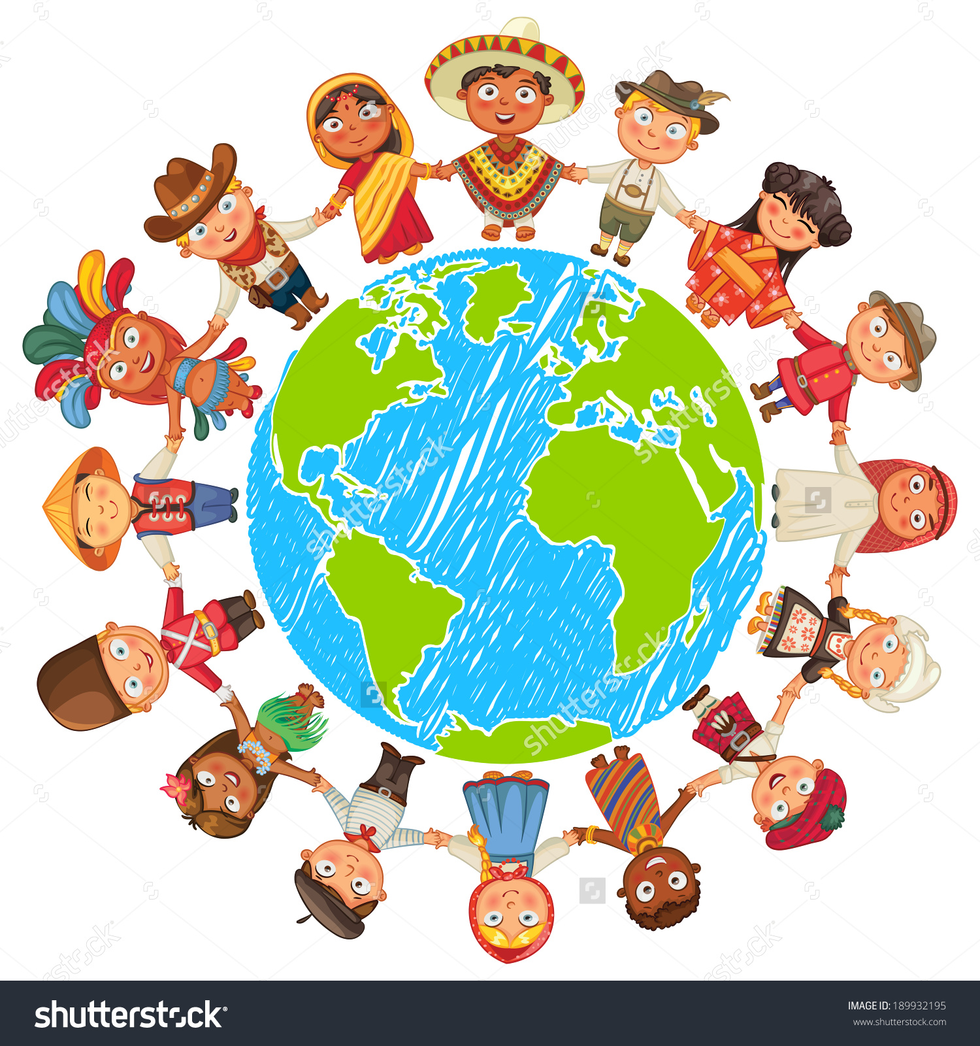
We are children of this world

Slide 4
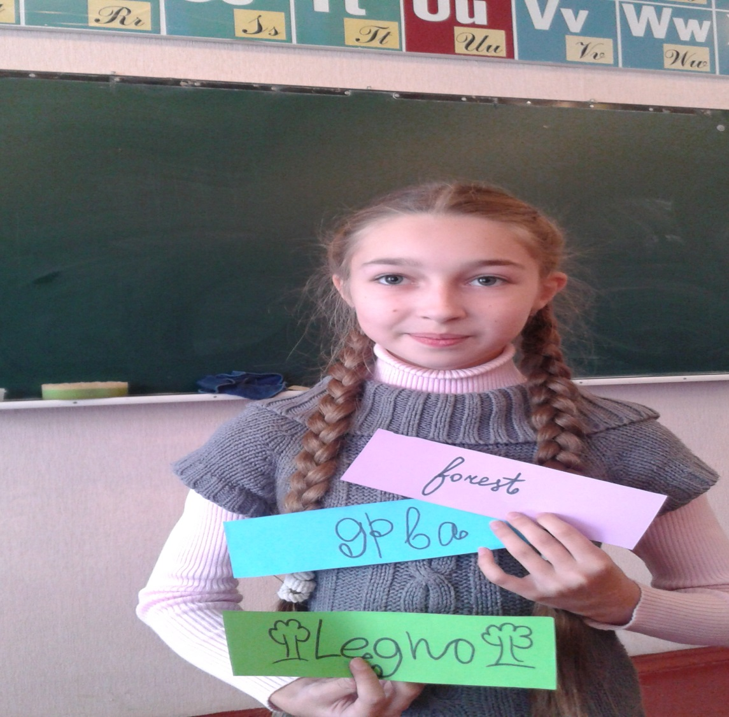
Forest
Wald
Drva
Legno
Ліс
Лес

Slide 5
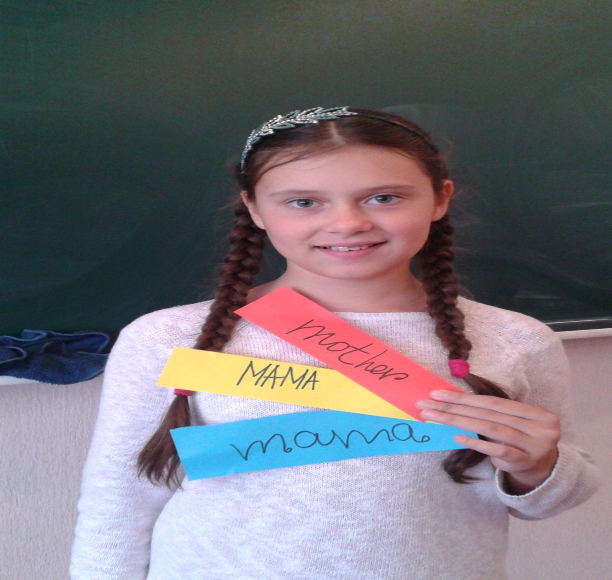
Mother
Mama
Mutter
Мати
Мама
Ненько

Slide 6
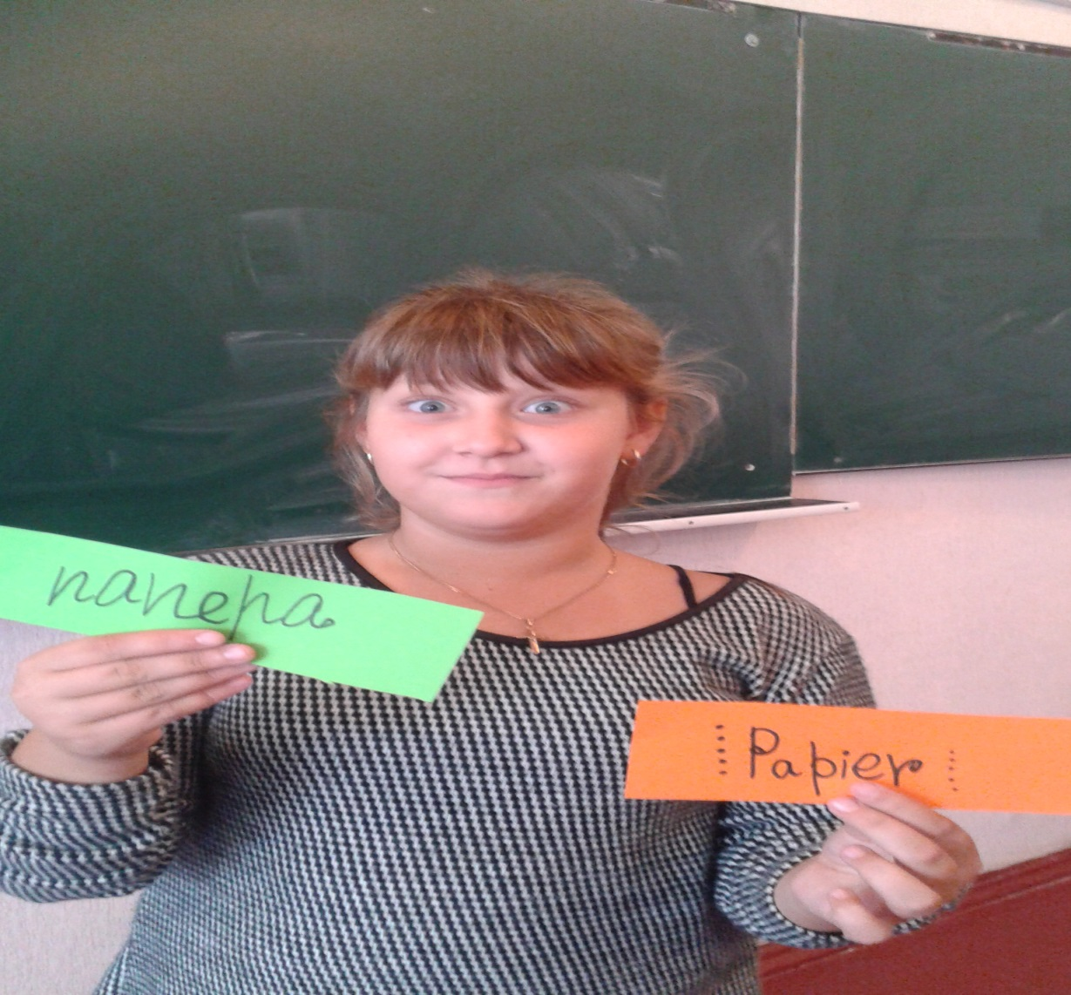
Paper
Papier
Папера
Папір
Бумага

Slide 7
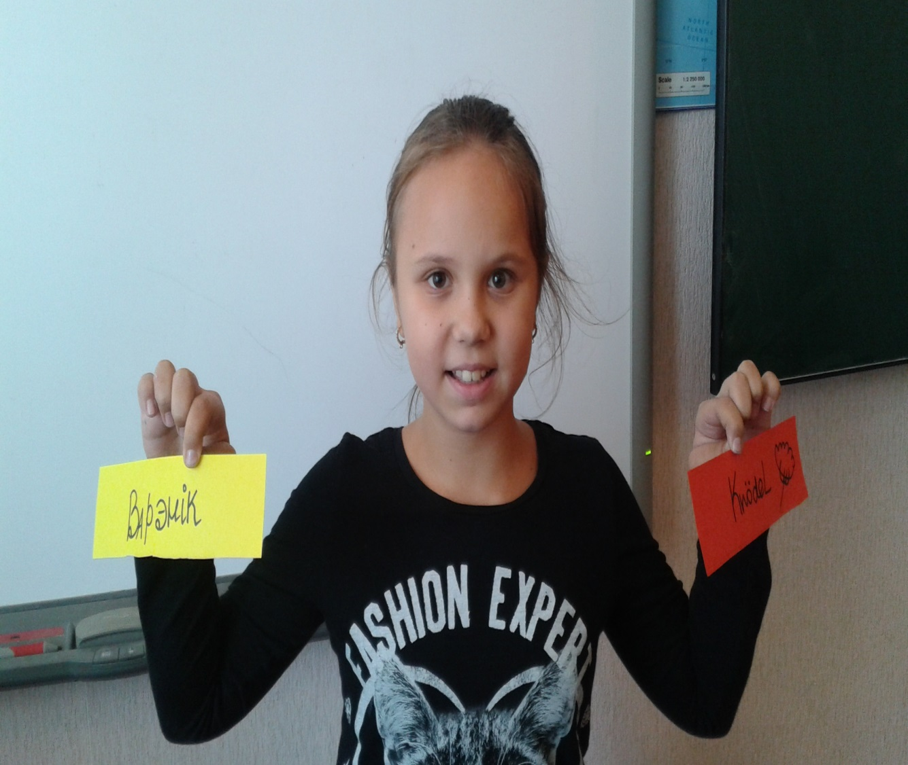
ВАРЕНИК
Варєнік
Varenik
Varynyk
Dish from
Ukraine
☺

Slide 8
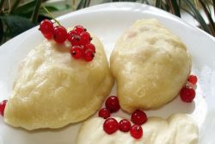
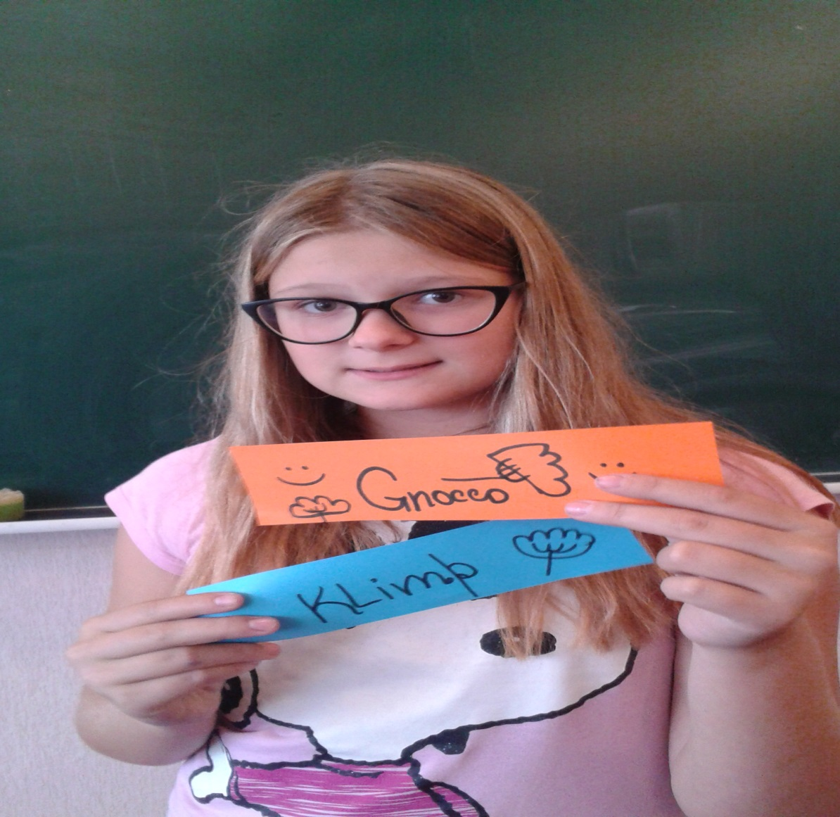
My favourite food! Varenyk!

Slide 9
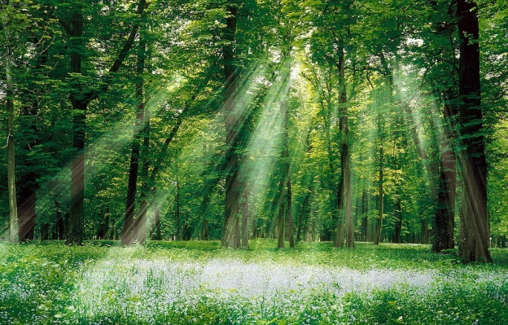
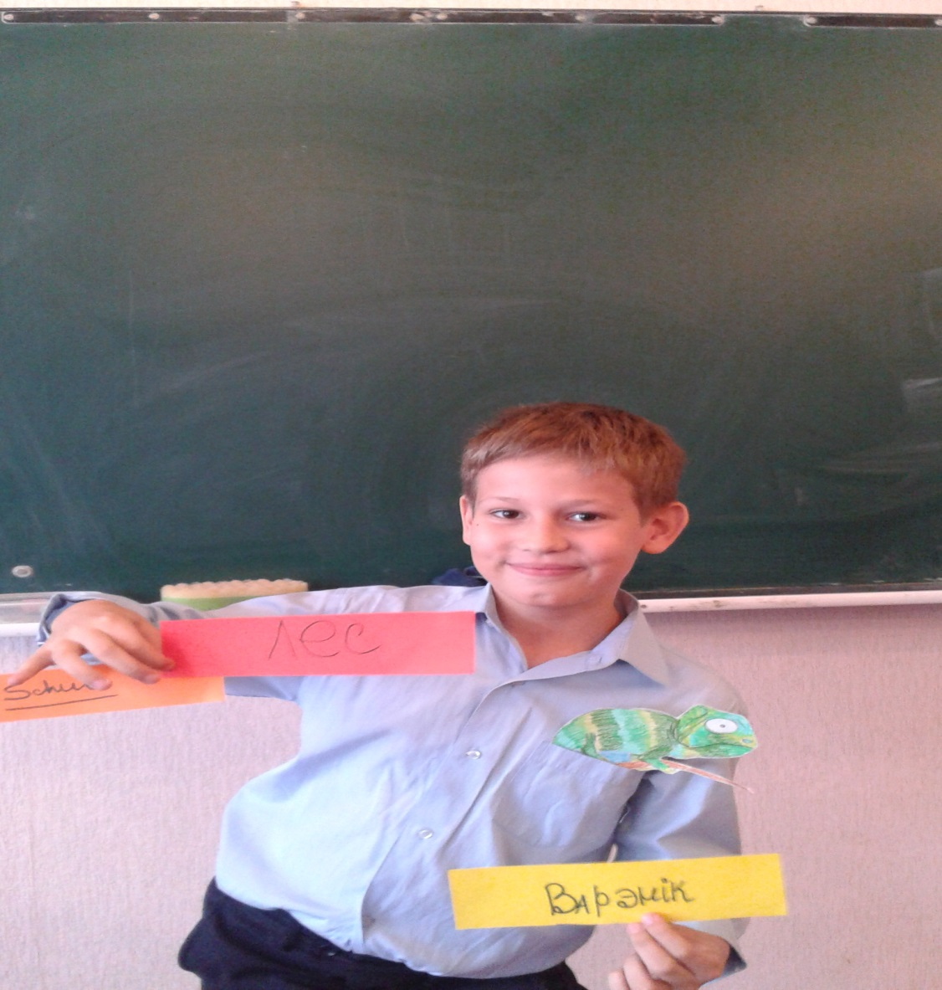
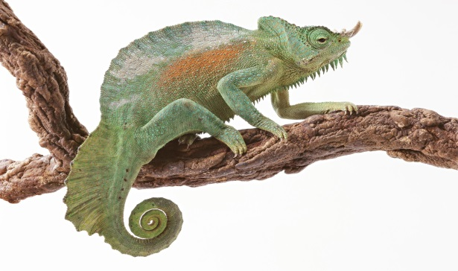
Forest, varenyk and my pet!!!

Slide 10

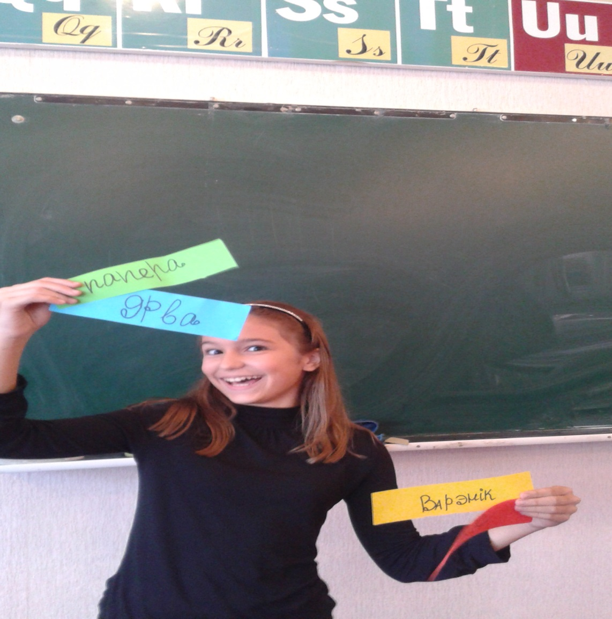
Guess my favourite words!

Slide 11
